Slide 1







DIGITAL SKILL FAIR DATA SCIENCE 35.0
WISCONSIN DIAGNOSTIC BREAST CANCER USING RANDOM FOREST CLASSIFICATION
MEIYIN MONICA AMILIA PUTRI

Slide 2



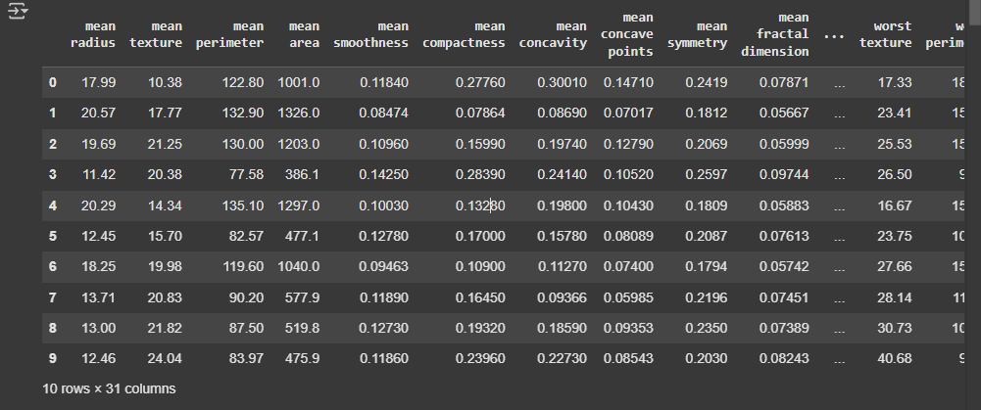


DATASET
The Wisconsin Diagnostic Breast Cancer (WDBC) dataset is used to diagnose breast cancer based on cell characteristics taken from fine needle aspiration images. The number of samples in this dataset is 569 and 31 columns. Each feature is calculated in three forms, namely average, standard error (SE), and worst value.
The purpose of this analysis is to predict whether the cancer is malignant or benign and to find out what the probability of each label is.

Slide 3

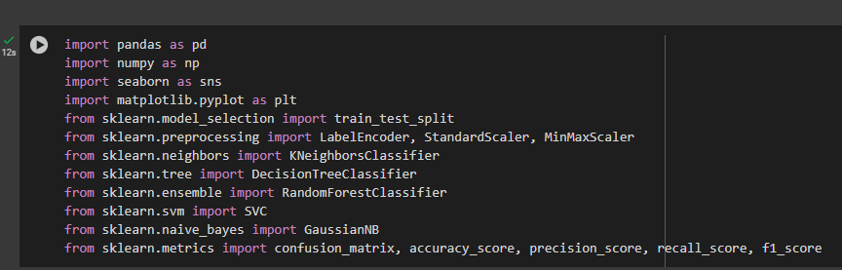



IMPORT LIBRARY
The first step is to import all the Python libraries that will be used in this data analysis.

Slide 4


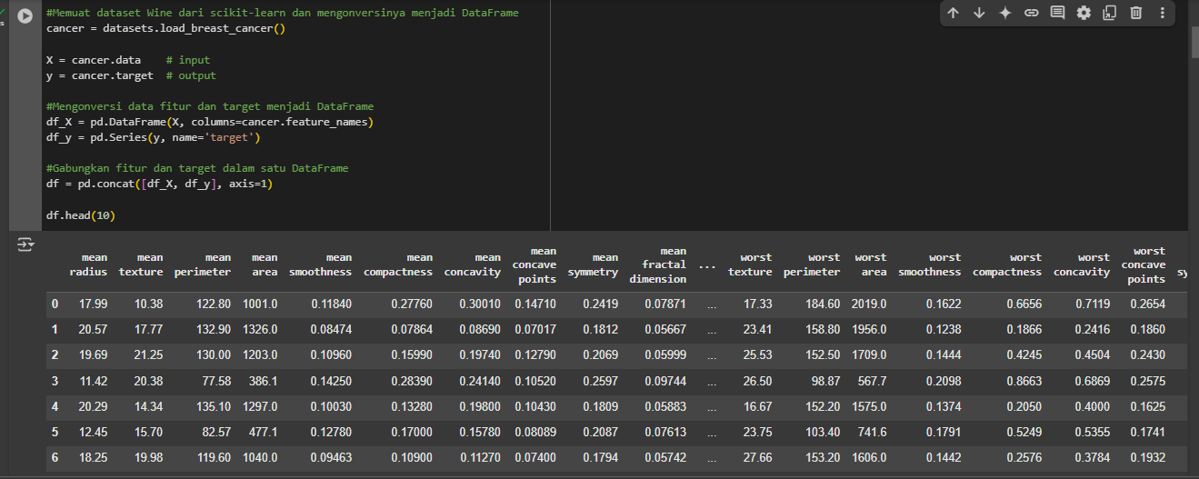



READ DATASET
This dataset consists of 30 columns divided into three forms: mean, standard error, and worst. The target dataset is divided into 2 categories, namely malignant and benign

Slide 5
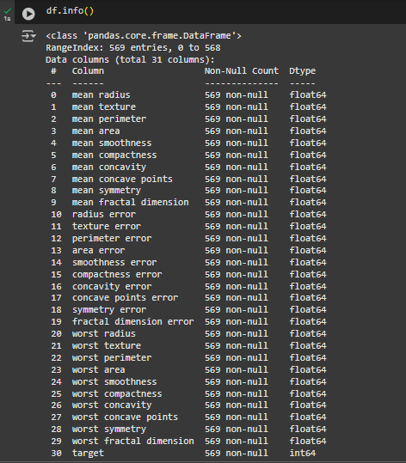
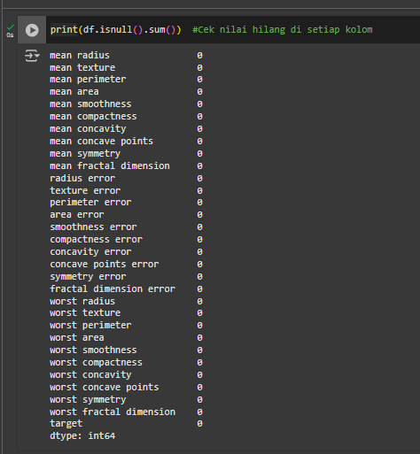
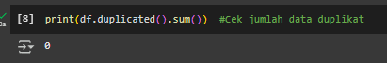
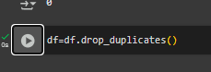
DATA PROCESSING
Check Data Info
Check Missing Value
Check Data Duplicated
Drop Duplicates

Slide 6
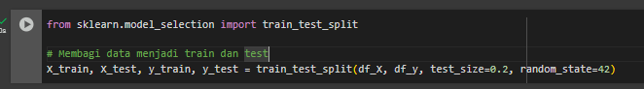
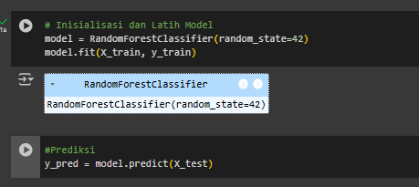
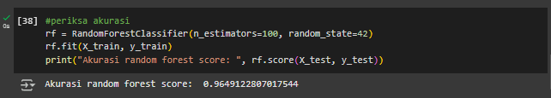
EXPLORATORY DATA ANALYSIS
(EDA)
Spliting the Data
Accuracy Model Random Forest
train a Random Forest model using training data to be used for prediction and evaluation accuracy.
The model shows an accuracy rate of 96.4%, which means the Random Forest algorithm is very good at classifying cancer as malignant and benign.

Slide 7

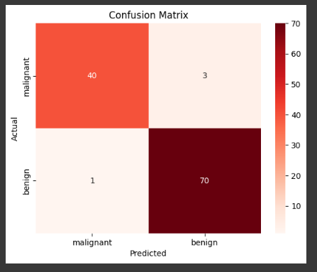
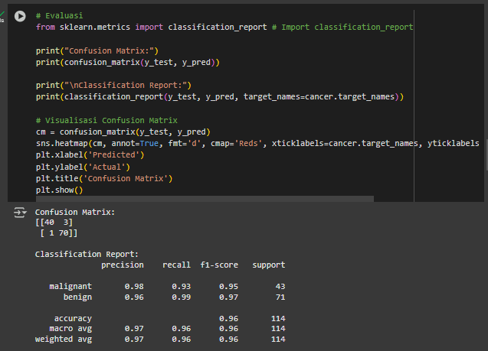

EXPLORATORY DATA ANALYSIS
(EDA)
Confusion Matrix
The confusion matrix shows that there are 40 samples declared malignant and 70 benign samples, with an f1-score accuracy level of 96% and a total number of samples tested is 114.

Slide 8




CONCLUSION
The random forest algorithm achieved an accuracy rate of 96.4% showing its reliability in predicting breast cancer datasets and grouping them into malignant and benign. Only 3 benign samples were incorrectly predicted as malignant and 1 malignant sample was incorrectly predicted as benign.
High precision, recall and F1-score of 96% indicate a stable and reliable model.

